Slide 1

AI POWERED REAL TIME SURVEILLANCE
Project Name : AI POWERED REAL TIME SURVEILLANCE
COLLEGE : BANNARI AMMAN INSTITUTE OF TECHNOLOGY
Team Members : AKASHPRABU A C
GOKUL E
YESWANTH S
THARUN A

Slide 2
Problem Statement
Coronavirus cases have hit the whole world, employers and employees alike are concerned about how the virus may spread through the workplace. Serious respiratory illnesses are generally spread through coughing or sneezing, touching objects with contaminated hands, and touching your face after touching contaminated objects, according to the Centers for Disease Control and Prevention (CDC).
Keeping the workplace clean and monitoring sanitization activities can inhibit the spread of communicable diseases. In addition to limiting exposure to the new strain of coronavirus—known as COVID-19. There is a need to sanitize the workspaces as well as monitor the workers whether they are following the safety measures like wearing the Mask or not. Keeping the environment clean is not only the important task, but also to maintain daily cleaning activities of workstations in office/any place. It is very difficult to maintain the log Sanitization and to keep an eye on the workers (No Mask) with personal supervision/ any checklist.

Slide 3
Proposed Solution
Regular Sanitization of workspaces is mandatory to maintain personnel safety in co-working spaces. It is very difficult to maintain a log of sanitization with personal supervision. In this project, we leverage the technology (IoT) to build a smart system to monitor the sanitization effectively at a low cost. Sanitization log is taken with help of hardware component like NFC Tags and NFC enabled Band or Mobile App. On the other hand the log is stored and maintained in DynamoDB. And a Face Mask Detection Platform which uses Deep Learning Technique to recognize if a user is not wearing a mask which is implement in CCTV cameras. If the camera captures an unrecognized face, a notification can be sent out to the administrator through SMS as well as E-Mail. In addition to that a log is maintained which is stored in the firebase along with face of the person who is not wearing the mask. All the informations are retrieved from firebase and DynamoDB to actual website where the admin can access, analysis and report the activities.This System can be implement in several work places.

Slide 4
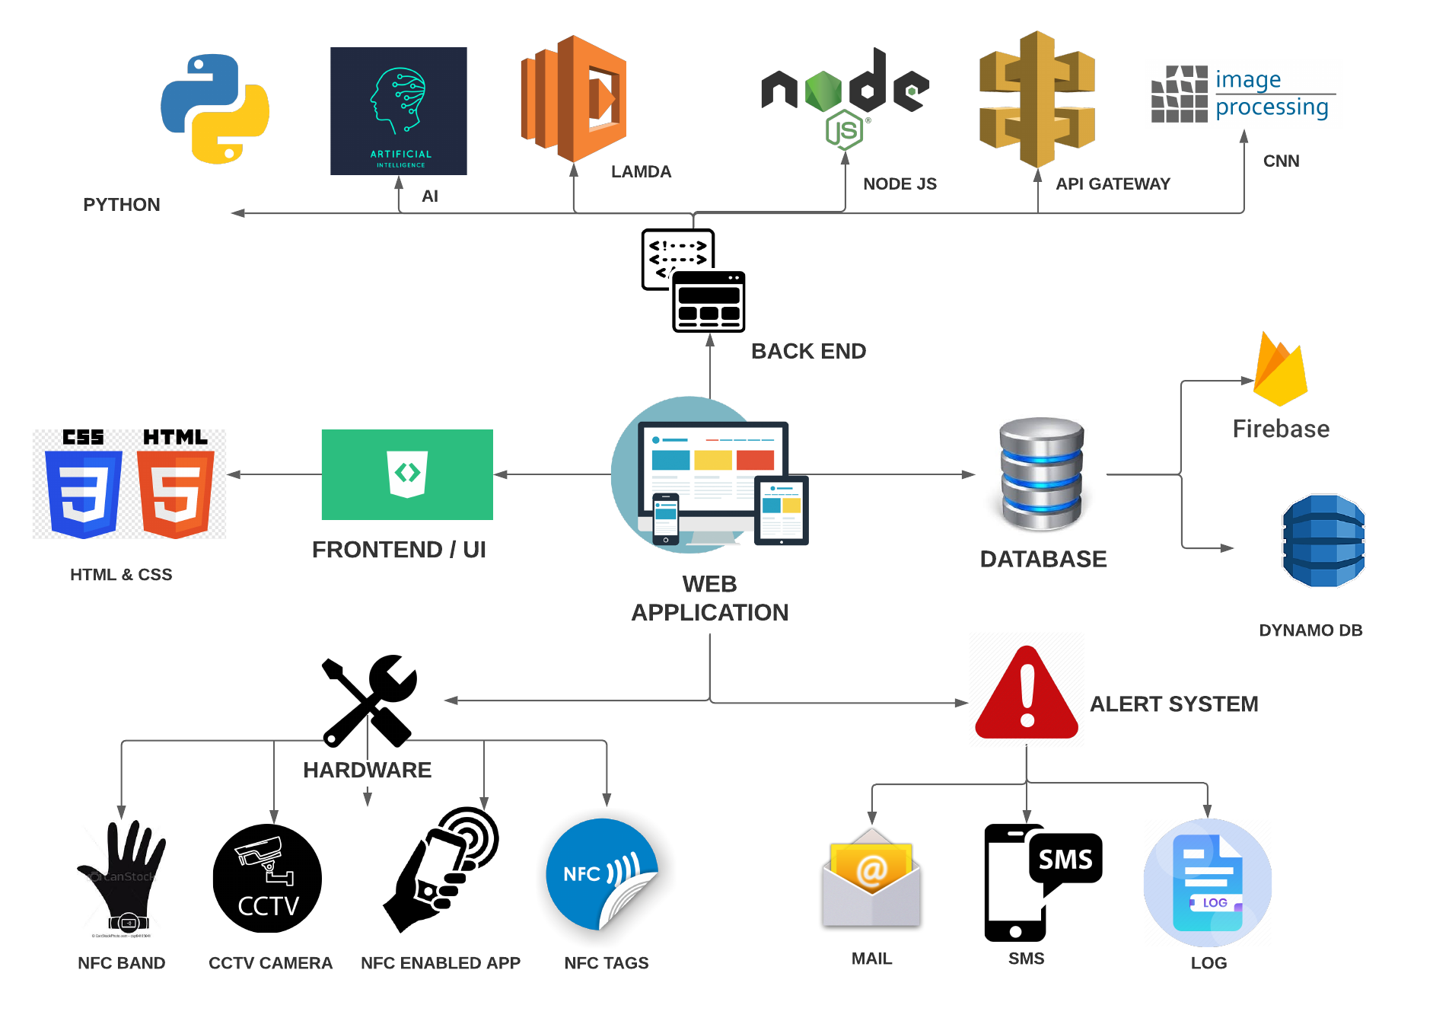
Proposed
TechStack

Slide 5











Sanitization Monitoring
Web Application
NFC tags
NFC Tags Enabled Office Rooms
ADMIN
NFC Enabled Mobile App
NFC bands
API Gateway
Lamba
Dynamodb
Lamba
API Gateway

Slide 6



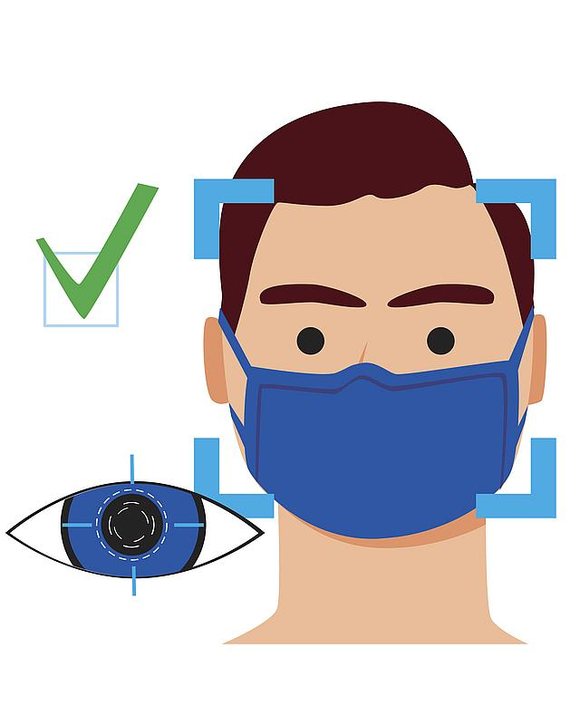




Face Mask Detection
WITHOUT MASK
With Mask
WEB APPLICATION
ADMIN
ALERT SYSTEM
Mail

Slide 7
Final Output
Alert
System
Without Mask
With Mask
ADMIN
WEB APPLICATION
Mail
NFC tags
API Gateway
NFC bands
Lamba
Dynamodb
Lamba
API Gateway
NFC Tags Enabled
Office Rooms
NFC mobiles

Slide 8
Advantages
AI sends the alert to the administrator through SMS and E-Mail.
Real Time Surveillance Log of No Mask Detection as well as Sanitization Log is maintained.
Low cost (IOT) smart system to monitor the sanitization is implemented.
IOT helps to maintain a clean environment.
Face Mask Detection with an accuracy of more than 90%.
Attach multiple cameras in a few minutes and enable all the cameras to access the AI capability of recognizing faces.
The system can work on any existing camera without the installation of any new cameras.
A user-friendly website allows the user to see who was not wearing a mask and see the photo captured by the camera.

Slide 9
Future Scope
A model can be trained with students images to identify their names from the log ( saved no mask pictures ) and they can be reported further.
AI powered Social Distancing along with Face Mask Detection can be implement in the same enhance the safety measures.
An automated counter can be implement to analysis a person like ( no of times No Mask Detection ).

Slide 10
Use Cases
The Face Mask Detection System can be used at airports to detect travelers without masks. Face data of travelers can be captured in the system at the entrance. If a traveler is found to be without a face mask, their picture is sent to the airport authorities so that they could take quick action. If the person’s face is already stored, like the face of an Airport worker, it can send the alert to the worker’s phone directly.
Using Face Mask Detection System, Hospitals can monitor if their staff is wearing masks during their shift or not. If any health worker is found without a mask, they will receive a notification with a reminder to wear a mask. Also, if quarantine people who are required to wear a mask, the system can keep an eye and detect if the mask is present or not and send notification automatically or report to the authorities.
The Face Mask Detection System can be used at office premises to detect if employees are maintaining safety standards at work. It monitors employees without masks and sends them a reminder to wear a mask.

Slide 11
Team Members
Team Member’s Name | College Name | Email ID
AKASHPRABU A C | Bannari Amman Institute of Technology | akashprabu.cs18@bitsathy.ac.in
GOKUL E | Bannari Amman Institute of Technology | gokule.cs18@bitsathy.ac.in
YESWANTH S | Bannari Amman Institute of Technology | yeswanth.cs18@bitsathy.ac.in
THARUN A | Bannari Amman Institute of Technology | tharun.cs18@bitsathy.ac.in

Slide 12
THANK YOU!

